Slide 1

Statistical Analysis of
US Wildfire
Team Members:
Shuai Shao 001345385
Haonan Quan 001305566
Lu Liu 001087120

Slide 2
Table of Contents
01
Introduction
02
Project Overview
03
Data Preparation
04
Data Visualization
Algorithms &
Implementation
05
06
Conclusion

Slide 3
01
Introduction

Slide 4
Wildfires
A wildfire is an unplanned, unwanted, uncontrolled fire in an area of combustible vegetation starting in rural areas and urban areas. Depending on the type of vegetation present, a wildfire can also be classified more specifically as a forest fire, brush fire, bushfire (in Australia), desert fire, grass fire, hill fire, peat fire, prairie fire, vegetation fire, or veld fire.
Just before the COVID-19 pandemic, wildfires in Australia destroyed more than 3,000 homes and burnt millions of hectares of vegetation.^{[1]} 3 month ago, California suffered wildfires and it is still ongoing. As of November 12, 2020, over 9,177 fires^{[2]} have burned 4,359,517 acres (1,764,234 ha),^{[3]} more than 4% of the state's roughly 100 million acres of land, making 2020 the largest wildfire season recorded in California's modern history (according to the California Department of Forestry and Fire Protection), though roughly equivalent to the pre-1800 levels which averaged around 4.4 million acres yearly and up to 12 million in peak years ^{[4][5]}.
Wildfires affect air quality, vegetation, human and animal habitats, and climate around the world. The intensity of the fires has been increased by drying and heating from human-induced climate change,^{[6][7]} as well as decades of poor forest management.
One of the most important ways to prevent wildfires is to predict the cause of wildfires and implement precise preventive measures. It is vital for the local fire department, state department to know how to take effective actions based on the causes of wildfires.
Statistical Analysis is one way to accomplish this important task.
In this project, we will show you how to analyze the dataset, visualize the data and implement various Machine Learning Algorithms to classify the causes of wildfires.
The whole model will take the fire part of this dataset and provide percentage ratings for all possible reasons that could cause wildfires.

Slide 5
Statistical Analysis
Statistical analysis is the science of collecting data and uncovering patterns and trends. It’s really just another way of saying “statistics.”
After collecting the data we can analyze it to:
Summarize the data. For example, make a pie chart.
Find key measures of location. For example, the mean tells you what the average (or “middling”) number is in a set of data.
Calculate measures of spread: these tell you if your data is tightly clustered or more spread out. The standard deviation is one of the more commonly used measures of spread; it tells you how spread out your data is about the mean.
Make future predictions based on past behavior. This is especially useful in retail, manufacturing, banking, sports or for any organization where knowing future trends would be a benefit.
Test an experiment hypothesis. Collecting data from an experiment only tells a story when you analyze the data. This part of statistical analysis is more formally called “Hypothesis Testing,” where the null hypothesis (the commonly accepted theory) is either proved or disproved.

Slide 6
02
Project Overview

Slide 7
Objectives
Listing out wildfire frequency from 1992 to 2015
Exploratory Data Analysis (EDA) and Data visualization
Figuring out the most and least fire-prone locations
Implement Machine Learning Algorithms and predict the causes of wildfires

Slide 8
Project Workflow
Importing Data
Data Pre-Processing
Data visualization
Algorithms Implementation
Improve the model
Compare different algorithms and conclusion

Slide 9
DataSet
Link: https://www.kaggle.com/rtatman/188-million-us-wildfires
Context:
This data publication contains a spatial database of wildfires that occurred in the United States from 1992 to 2015. It is the third update of a publication originally generated to support the national Fire Program Analysis (FPA) system. The wildfire records were acquired from the reporting systems of federal, state, and local fire organizations. The following core data elements were required for records to be included in this data publication: discovery date, final fire size, and a point location at least as precise as Public Land Survey System (PLSS) section (1-square mile grid). The data were transformed to conform, when possible, to the data standards of the National Wildfire Coordinating Group (NWCG). Basic error-checking was performed and redundant records were identified and removed, to the degree possible. The resulting product, referred to as the Fire Program Analysis fire-occurrence database (FPA FOD), includes 1.88 million geo-referenced wildfire records, representing a total of 140 million acres burned during the 24-year period.

Slide 10
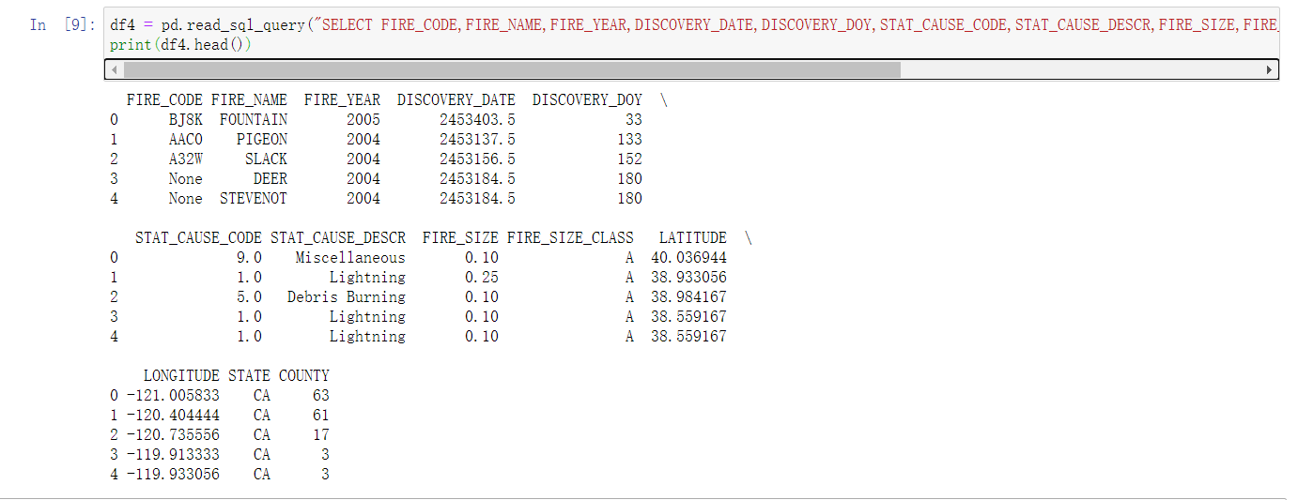
Columns In DataSet
Main Information:

Slide 11
Columns In DataSet
Each Colunm stands for
FIRE_CODE = Code used within the interagency wildland fire community to track and compile cost information for emergency fire suppression (https://www.firecode.gov/).
FIRE_NAME = Name of the incident
FIRE_YEAR = Calendar year in which the fire was discovered
DISCOVERY_DATE = Date on which the fire was discovered
DISCOVERY_DOY = Day of year on which the fire was discovered
STAT_CAUSE_CODE = Code for the (statistical) cause of the fire.
STAT_CAUSE_DESCR = Description of the (statistical) cause of the fire.
FIRE_SIZE = Estimate of acres within the final perimeter of the fire.
FIRE_SIZE_CLASS = Code for fire size based on the number of acres within the final fire perimeter expenditures (A= 0-0.25 acres, B=0.26-9.9 acres, C=10.0-99.9 acres, D=100-299 acres, E=300 to 999 acres, F=1000 to 4999 acres, and G=5000+ acres).
LATITUDE = Latitude for point location of the fire (decimal degrees).
LONGITUDE = Longitude for point location of the fire (decimal degrees).
STATE = Two-letter alphabetic code for the state in which the fire burned (or originated)
COUNTY = County, or equivalent, in which the fire burned (or originated)

Slide 12
Algorithms Used
Algorithms:
Linear Regression
Gaussian Naive Bayes
Logistic Regression
Decision Tree
Random Forest

Slide 13
03
Data Preparation

Slide 14
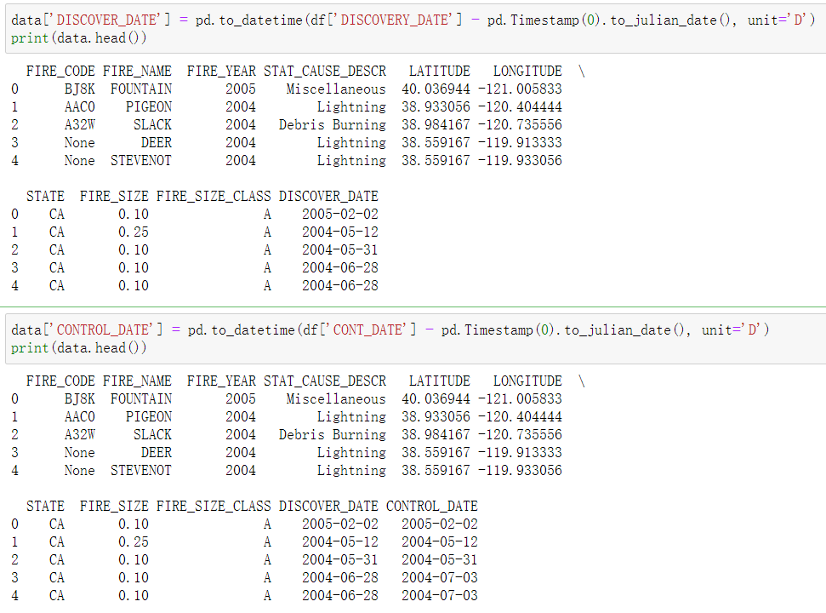
Importing Data
We implemented sqlite3 to import the dataset and show the head.
We chose the data mentioned before and transferred to julian date for better understanding.

Slide 15
04
Data Visulization

Slide 16
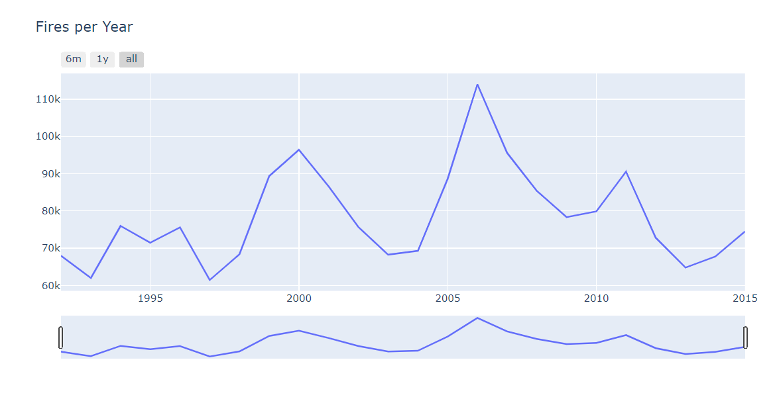
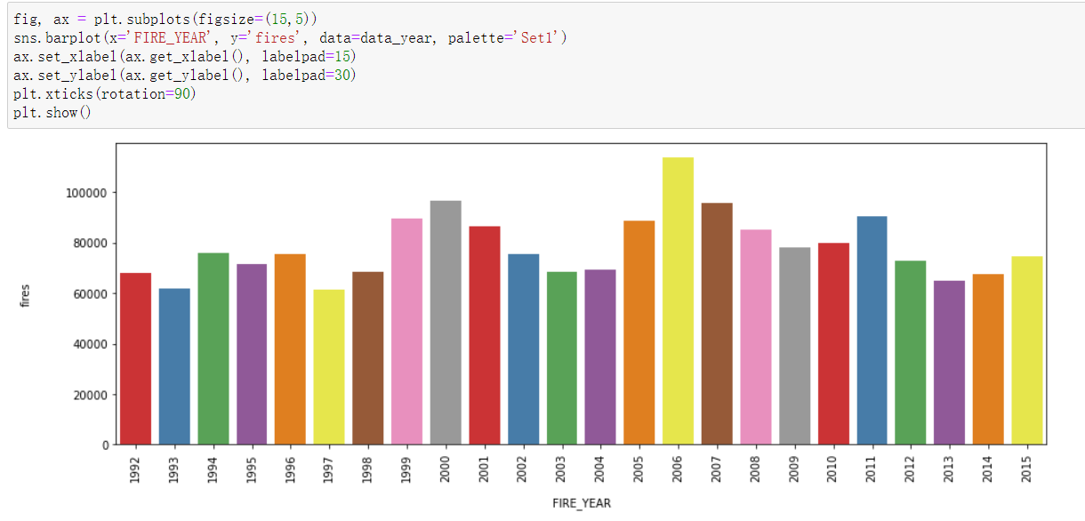
Visulization
Timeline
We created a timeline and chart of fires per year. It showed that after the peak of 2006, total numbers of wildfires per year present a decreasing trend.

Slide 17
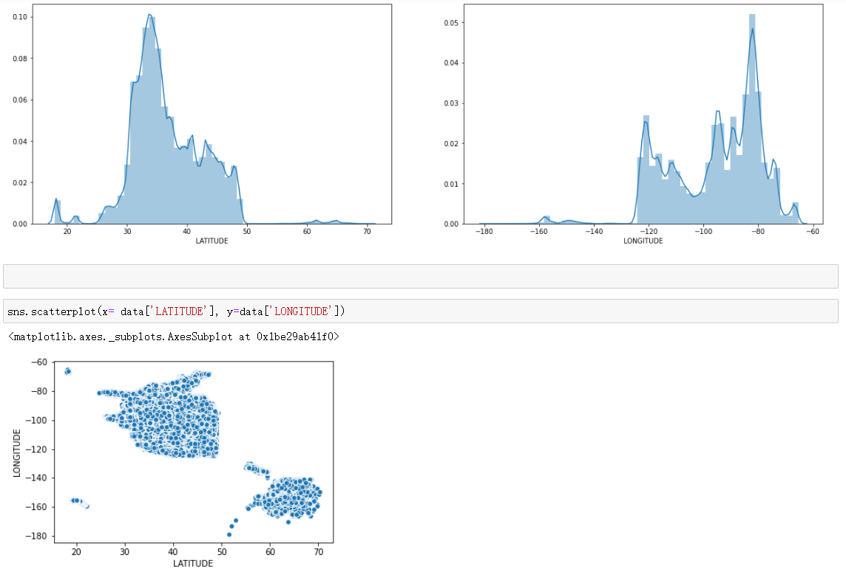
Visulization
latitude/longitude Analysis
We then tried to analyze at which latitude and longitude did wildfire happen most, getting the result of latitude around 34 and longitude around -80.

Slide 18
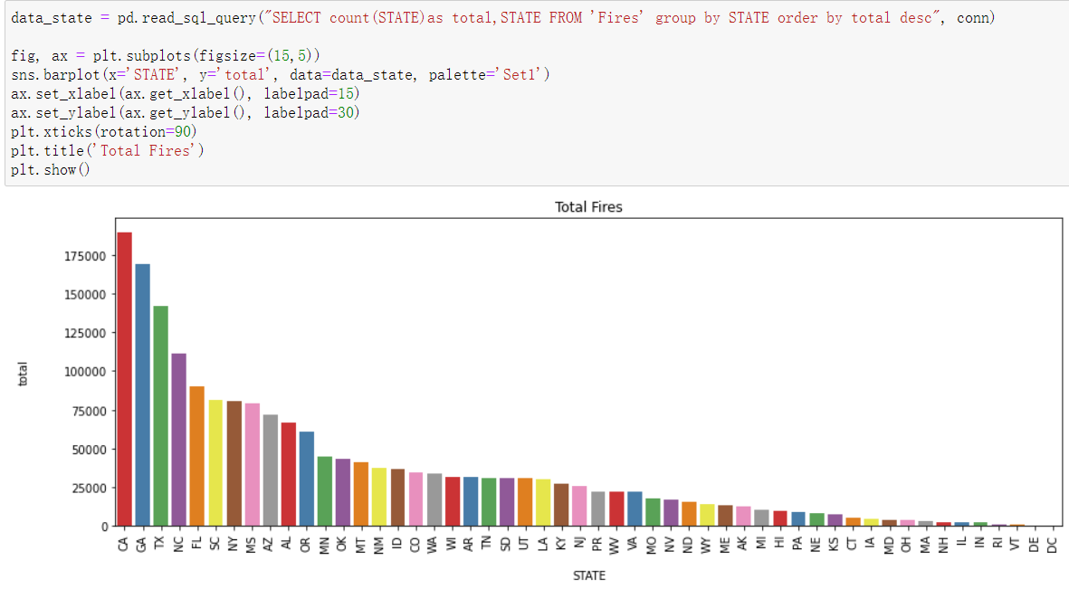
Visulization
Total Fires
After creating the chart of the total fires for each state, we found CA, GA, and TX were the top three, which verified our analysis of latitude and longitude.

Slide 19
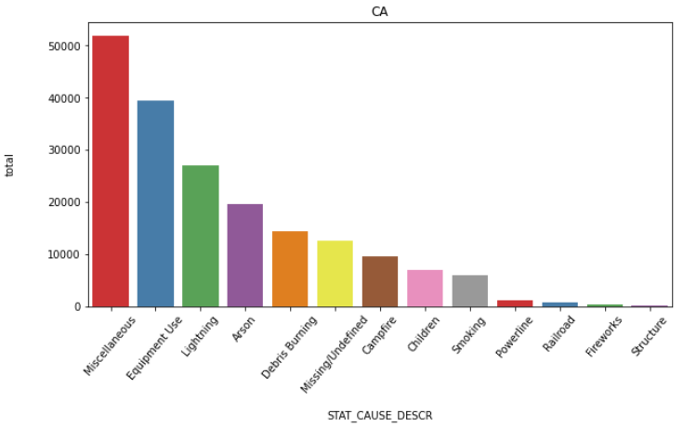
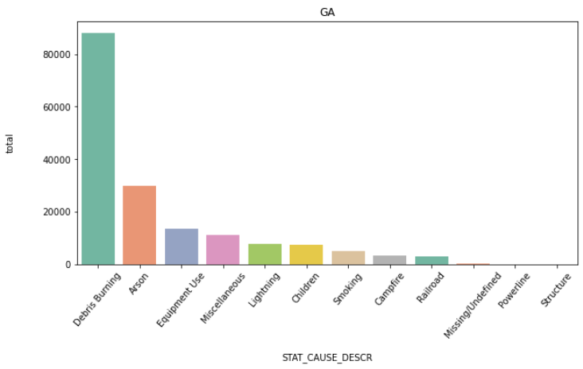
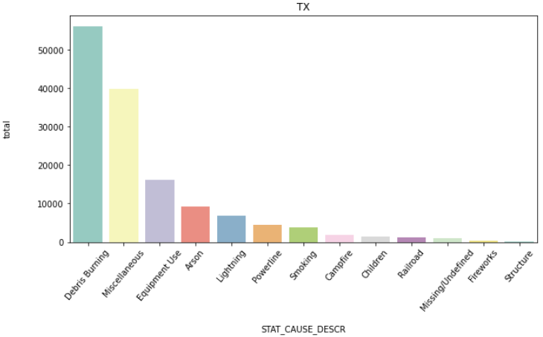
Visulization
Fire causes
We analyzed the fire causes of the top 3 states: CA, GA, TX

Slide 20
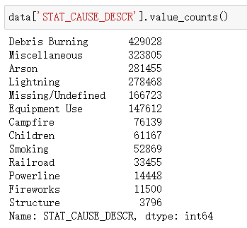
Visulization
Fire causes
We also summed the total amounts of fire causes but it seemed difficult to summarize the pattern of causes.

Slide 21
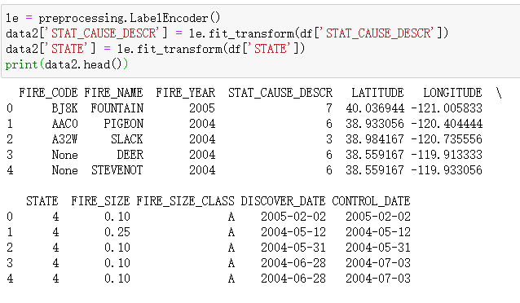
Visulization
Correlation
We first transferred the states and causes to numeric numbers.

Slide 22
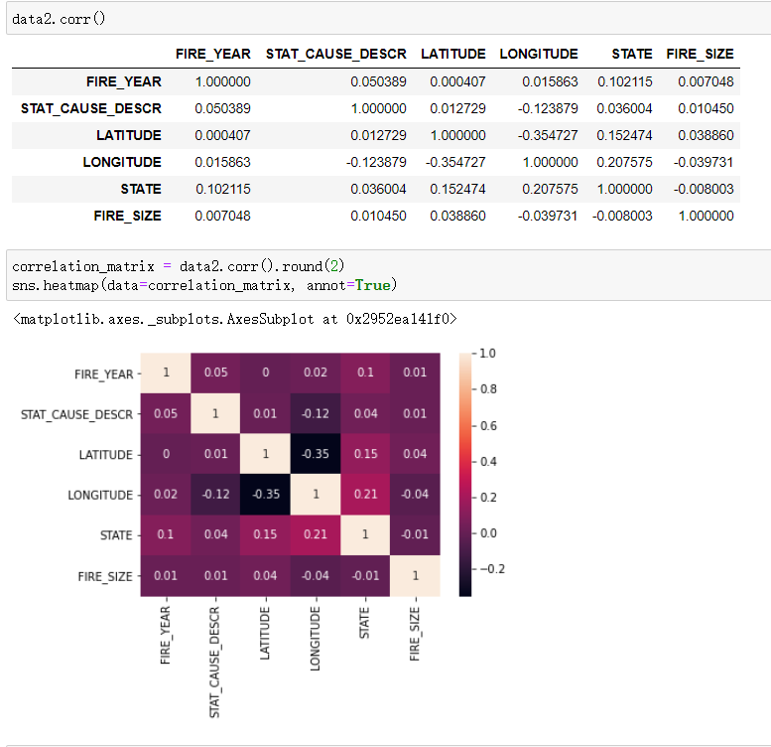
Visulization
Correlation
We then tried to calculate the correlations, but found out the dataset didn’t show a strong correlation. The next step was to implement some algorithms to analyze the data.

Slide 23
05
Algorithms and Implementation

Slide 24
Algorithms and Implementation
Algorithms:
Linear Regression
Gaussian Naive Bayes
Logistic Regression
Decision Tree
Random Forest

Slide 25
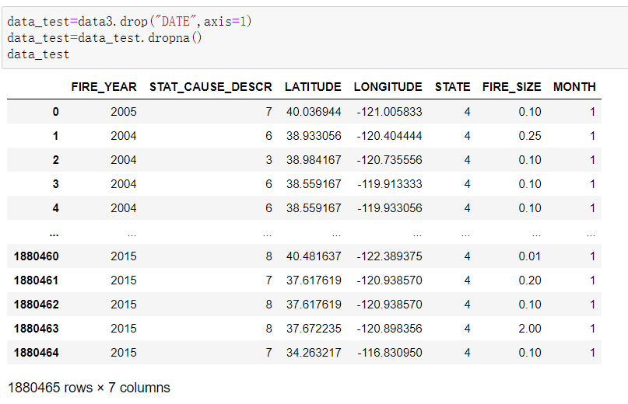
Algorithms and Implementation
Linear Regression
Our first try was LinearRegression. Linear regression attempts to model the relationship between two variables by fitting a linear equation to observed data. One variable is considered to be an explanatory variable, and the other is considered to be a dependent variable. For example, a modeler might want to relate the weights of individuals to their heights using a linear regression model.^{[8]}
For our model, we employed the dataset used before for correlation, and added a column named month. We then dropped the null values and showed the header information.

Slide 26
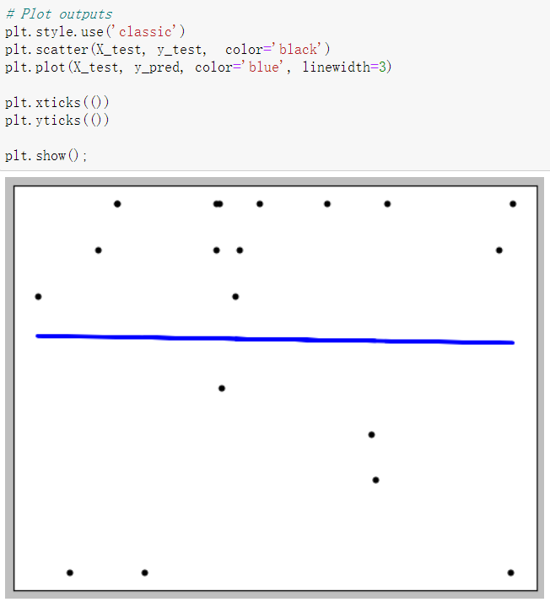
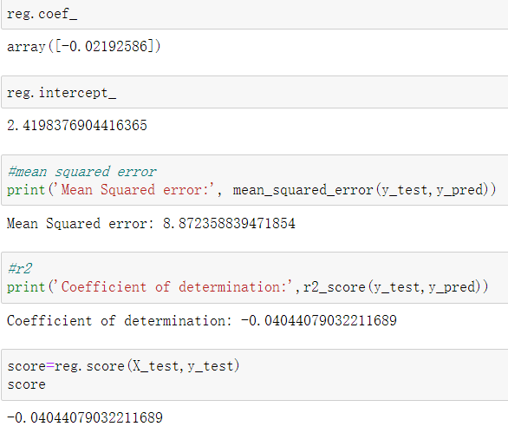
Algorithms and Implementation
Linear Regression
We then picked the data and trained them, calculating the mean squared error, coefficient and score.
We plotted the diagram and calculated the score, which didn’t show a satisfying result. We had to jump to the next algorithm, Gaussian Naive Bayes.

Slide 27
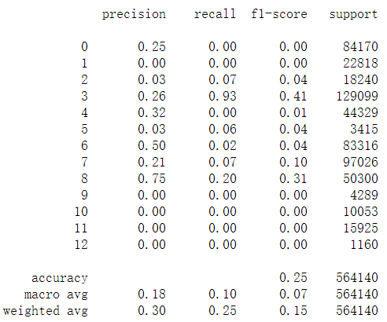
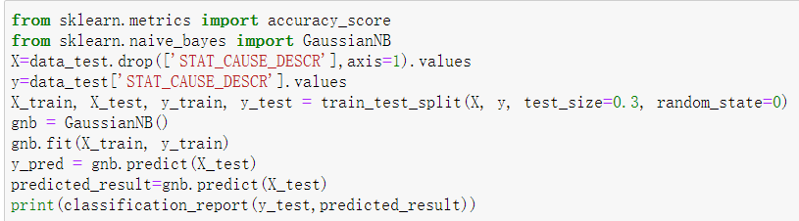
Algorithms and Implementation
Gaussian Naïve Bayes
As the name suggests, Gaussian Naïve Bayes classifier assumes that the data from each label is drawn from a simple Gaussian distribution. The Scikit-learn provides sklearn.naive_bayes.GaussianNB to implement the Gaussian Naïve Bayes algorithm for classification.^{[9]}
We followed the steps from lectures, imported the Gaussian Naive Bayes model, created a Gaussian Classifier, trained the model and predicted the response for the test dataset. We finally came to an accuracy of around 25%, which wasn’t what we wanted.

Slide 28
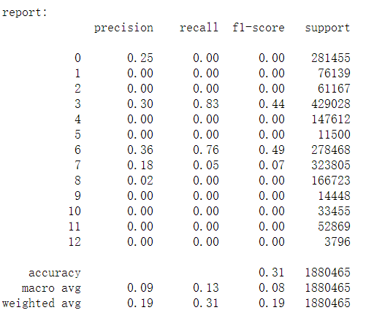
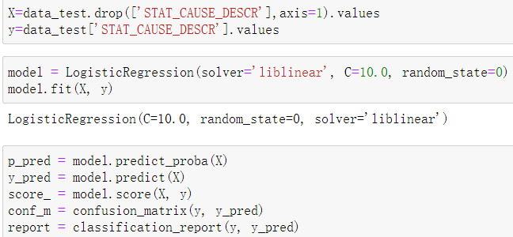
Algorithms and Implementation
Logistic Regression
Logistic regression (LR) is a statistical method similar to linear regression since LR finds an equation that predicts an outcome for a binary variable, Y, from one or more response variables, X. However, unlike linear regression the response variables can be categorical or continuous, as the model does not strictly require continuous data.^{[10]}
We worked with the dataset while regularization strength C set to 10.0 instead of the default value. We then trained and evaluated the model, getting an accuracy of around 31%.

Slide 29
Algorithms and Implementation
Decision Tree
A decision tree is a flowchart-like structure in which each internal node represents a "test" on an attribute (e.g. whether a coin flip comes up heads or tails), each branch represents the outcome of the test, and each leaf node represents a class label (decision taken after computing all attributes). The paths from root to leaf represent classification rules.^{[11]}
The topmost node in a decision tree is known as the root node. It learns to partition based on the attribute value. It partitions the tree in recursive manner call recursive partitioning.
This flowchart-like structure helps you in decision making. It's visualization like a flowchart diagram which easily mimics the human level thinking. That is why decision trees are easy to understand and interpret.

Slide 30
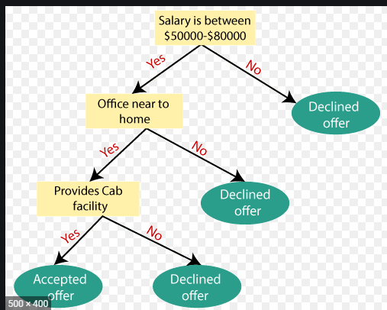
Algorithms and Implementation
Decision Tree

Slide 31
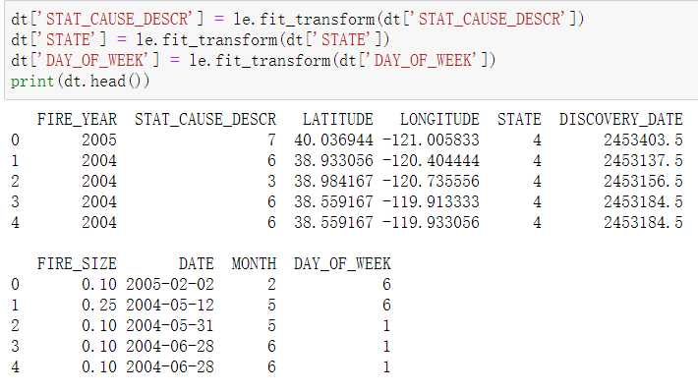
Algorithms and Implementation
Decision Tree
Implementation:
Listed out some of the data required, transferred some data to numeric numbers.

Slide 32
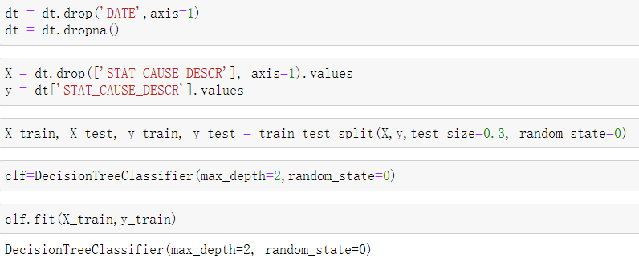
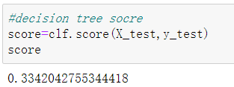
Algorithms and Implementation
Decision Tree
We then trained the data and came out with a score of 33%. It still wasn’t what we wanted, so we had to turn to our last hope: random forest.

Slide 33
Algorithms and Implementation
Random Forest
Random forests or random decision forests are an ensemble learning method for classification, regression and other tasks that operate by constructing a multitude of decision trees at training time and outputting the class that is the mode of the classes (classification) or mean/average prediction (regression) of the individual trees.
The fundamental concept behind random forest is a simple but powerful one — the wisdom of crowds. In data science speak, the reason that the random forest model works so well is:
A large number of relatively uncorrelated models (trees) operating as a committee will outperform any of the individual constituent models.
Based on this theory and the correlation work we achieved before, Random Forest seems to be the best model to help us solve the problem

Slide 34
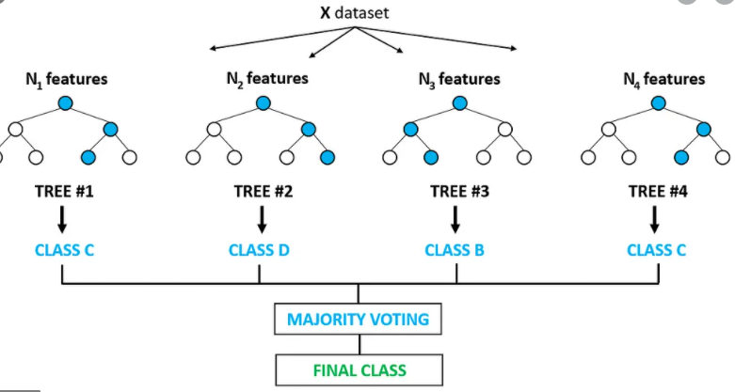
Algorithms and Implementation
Random Forest

Slide 35
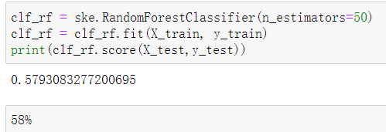
Algorithms and Implementation
Random Forest
Implementation:
The 58% score was much better than before. We wanted to focus a bit more on fire causes, so we classify the causes into 4 classes: natural, accidental, malicious and other.

Slide 36
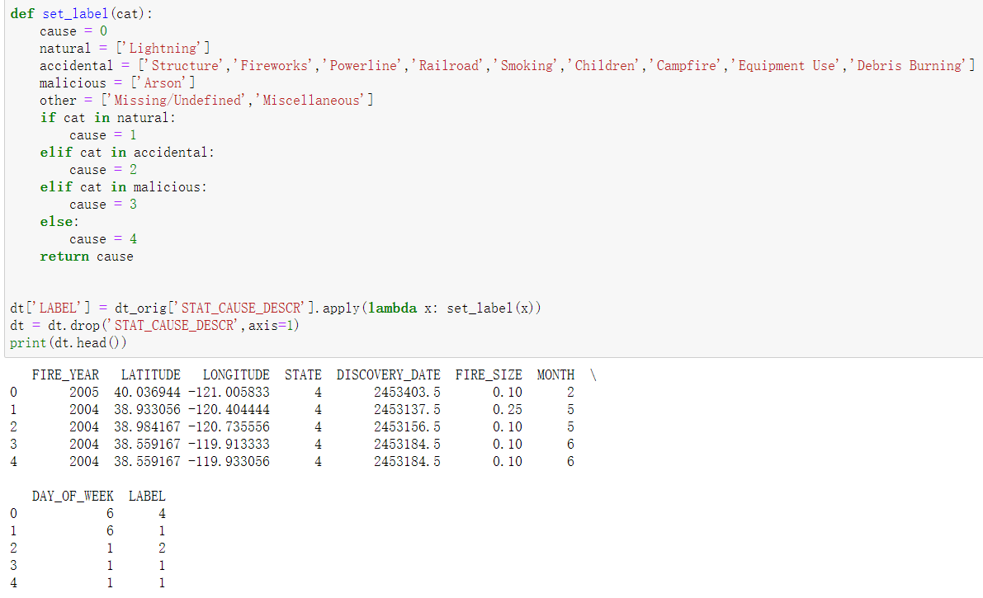
Algorithms and Implementation
Random Forest
The 58% score was much better than before. We wanted to focus a bit more on fire causes, so we classify the causes into 4 classes: natural, accidental, malicious and other.

Slide 37
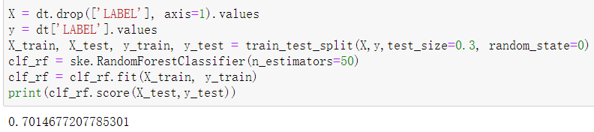
Algorithms and Implementation
Random Forest
We then did a random forest test based one the new dataset, which gave a 70% score.
It seems we are on the right track. Let’s do some visualization to see the details in next slides.

Slide 38
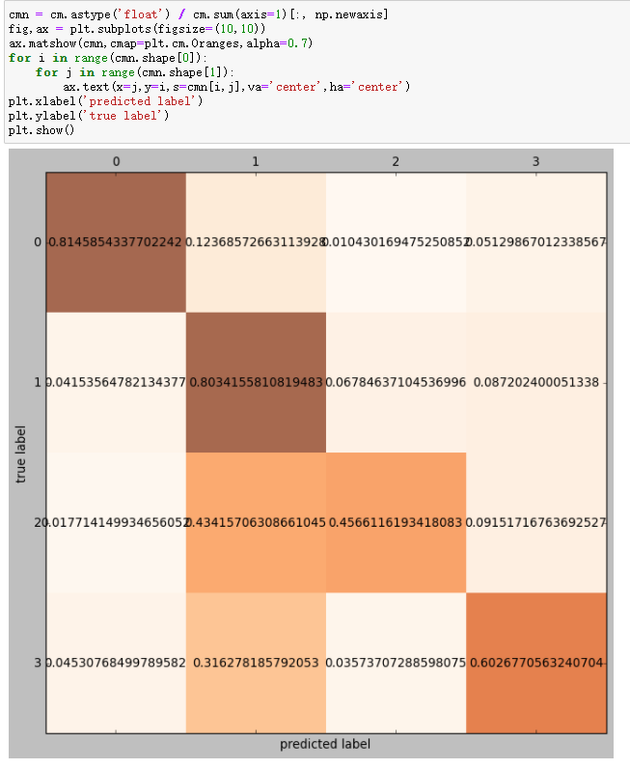
Algorithms and Implementation
Random Forest
Here we can see that the model did quite good at the first and second fire cause natural and accidental. It didn’t do as well with other part(60 %) and it did badly at malicious label.
As you can see from this picture, it mistakenly labeled many malicious as accidental. (Predict label ‘2’ -> label ‘1’)
Overall, the original problem is “Can we use Machine Learning to predict the cause of wildfires?”
Yes,we can. However it didn’t perform well when it trying to distinguish accidental and malicious.
Next question is can we do it better? Let’s give a try.

Slide 39
Algorithms and Implementation
Random Forest
Problem: Our model did badly at malicious part.
Improve the model?
We can do it by tuning algorithms. Our former model focus on the whole US wildfires and try to classify the causes into four classes. This time, we focus on one single state with one fire cause, malicious.
Our next step was to see if we could predict malicious fires in one state. We chose the top 3 states of wildfires: CA, GA and TX.
In order to improve the accuracy we could drop some columns to do that.

Slide 40
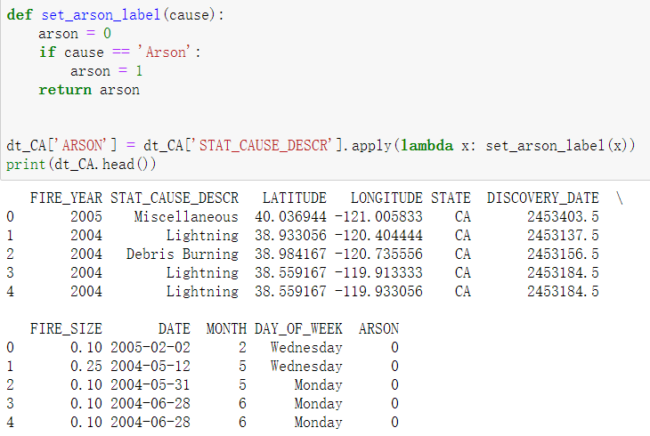
Algorithms and Implementation
Random Forest
CA:
Let’s go with California first.
In order to do that, we should create a new filed named Arson.

Slide 41
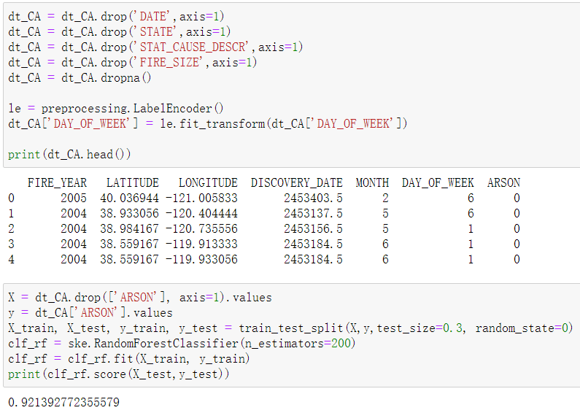
Algorithms and Implementation
Random Forest
Then we drop DATE and STAT_CAUSE_DESCR like we did before, and since we only focus on one State, we need to drop STATE field too. Also we should drop Fire_Size.
We got a 92% score!

Slide 42
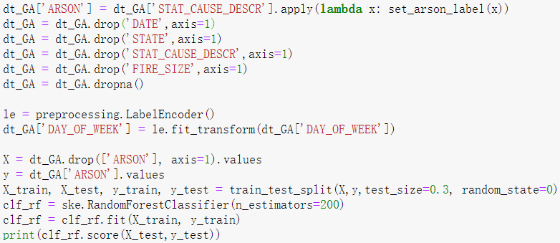

Algorithms and Implementation
Random Forest
GA:
Let’s go with Georiga.
We need to go through the process again.
We got 85% score.

Slide 43
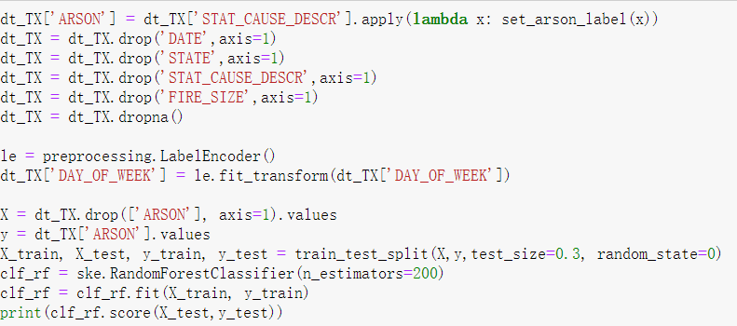

Algorithms and Implementation
Random Forest
TX:
Let’s go with Texas.
94!

Slide 44
Conclusion
We have performed extract data by querying the partial columns of the fire table and we plotted the data to help us better understand the meaning behind the scenes. Post that, we implemented different Supervised Machine Learning Algorithms to check the ability of these models to learn from the training data set and make correct predictions on the test data set.
We use Longitude, Latitude, Fire Date, Fire size, Day of the week, State, etc as our parameter. And we dropped some fields in next steps to get a more accurate prediction.
Among all the 5 models used in this project, Random Forest turns out to be the best model among them with a 70% predicted probability score. badly at the malicious part, so in the next step, we dropped fire_size. The model did field and did a more precise work by focusing on one state to determine whether the cause of wildfires in this state is malicious. Then we got a 90% predicted score.
Overall, Random Forest turns out to be a good way to predict the causes of wildfires in US

Slide 45
References
Bowman, D., Williamson, G., Yebra, M., Lizundia-Loiola, J., Pettinari, M., Shah, S., . . . Chuvieco, E. (2020, August 12). Wildfires: Australia needs national monitoring agency. Retrieved November 12, 2020, from https://www.nature.com/articles/d41586-020-02306-4
Fire Statistics. CAL FIRE. October 23, 2020. Retrieved October 27, 2020.
2020 National Large Incident Year-to-Date Report (PDF). Geographic Area Coordination Center(Report). National Interagency Fire Center. October 27, 2020. Retrieved October 27, 2020.
Holly Yan; Cheri Mossberg; Artemis Moshtaghian; Paul Vercammen (September 6, 2020). California sets new record for land torched by wildfires as 224 people escape by air from a 'hellish' inferno. Cable News Network. Retrieved September 6, 2020.
Silverman, Hollie (September 8, 2020). California wildfires have burned more than 2 million acres and prompted power outages for more than 170,000. CNN. Retrieved September 8, 2020.
Williams, A. Park; Abatzoglou, John T.; Gershunov, Alexander; Guzman‐Morales, Janin; Bishop, Daniel A.; Balch, Jennifer K.; Lettenmaier, Dennis P. (2019). Observed Impacts of Anthropogenic Climate Change on Wildfire in California. Earth's Future. 7 (8): 892–910. doi:10.1029/2019EF001210. ISSN 2328-4277.
Temple, James (August 20, 2020). Yes, climate change is almost certainly fueling California's massive fires. MIT Technology Review.
(n.d.). Retrieved December 03, 2020, from http://www.stat.yale.edu/Courses/1997-98/101/linreg.htm
Scikit Learn - Gaussian Naïve Bayes. (n.d.). Retrieved December 03, 2020, from https://www.tutorialspoint.com/scikit_learn/scikit_learn_gaussian_naive_bayes.htm
Hoffman, J. I. (2019). Logistic Regression Analysis. Retrieved December 03, 2020, from https://www.sciencedirect.com/topics/medicine-and-dentistry/logistic-regression-analysis
Decision tree. (2020, October 13). Retrieved December 03, 2020, from https://en.wikipedia.org/wiki/Decision_tree
Yiu, T. (2019, August 14). Understanding Random Forest. Retrieved December 03, 2020, from https://towardsdatascience.com/understanding-random-forest-58381e0602d2

Slide 46
Thank You !

